Slide 1
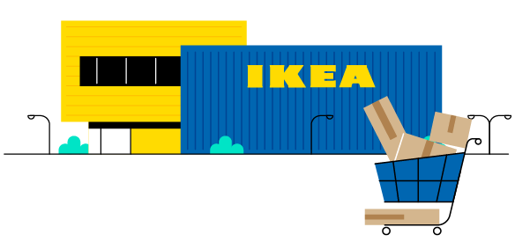
Precision Retail Marketing Analytics:
Restoring Omnichannel Profitability for IKEA India
Addressing CAC inflation, small-basket delivery deficits, and flatpack assembly friction via Marketing Mix Modelling, Apriori Basket Mining, and Strategic Perceptual Repositioning.
PILLAR 1 — MARKETING MIX MODELLING
Shift ₹7.0 Cr from saturated Meta/Search to WhatsApp & Video. Delivers +₹14.99 Cr Net Gain (+13.5% lift) at ₹0 extra budget.
PILLAR 2 — MARKET BASKET ANALYSIS
Mine 1,222 transactions using 2-Stage Apriori. Converts single carts into room suites, lifting AOV from ₹4,200 to ₹5,100+.
PILLAR 3 — STRATEGIC REPOSITIONING
Construct PCA perceptual map (N=450). Isolates vacant 'Affordable Turnkey' whitespace, bridging cultural resistance to DIY.
1

Slide 2
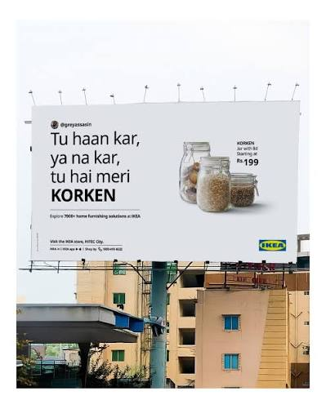
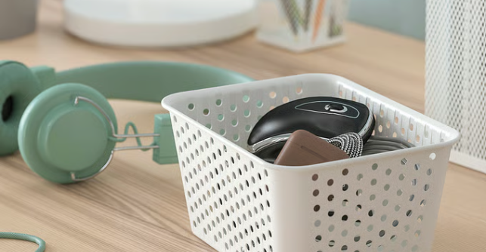
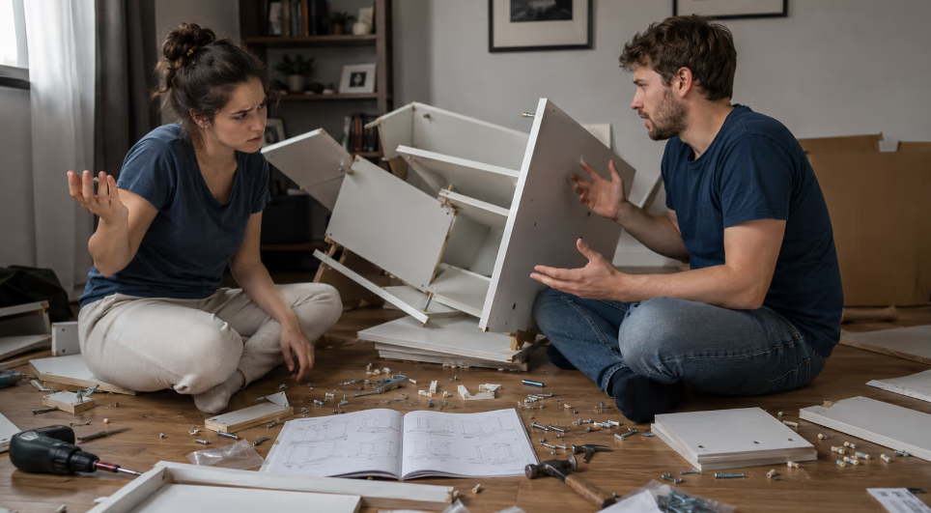
1. STRATEGIC DIAGNOSTIC
IKEA India's Tri-Fold Profitability Crisis Demands Immediate Analytical Intervention
Omnichannel expansion exposed IKEA to digital CAC inflation, low-ticket freight drag, and cultural resistance to self-assembly.
ANNUAL REVENUE (FY24)
₹1,809.8 Cr
+4.5% YoY (Growth Slower)
NET OPERATING LOSS
₹1,299.4 Cr
Widened Operating Deficit
ANNUAL MEDIA SPEND
₹196.3 Cr
~₹3.77 Cr Weekly Run-Rate
ONLINE BASKET (AOV)
₹4,200
35.7% Single-Item Orders
LAST-MILE FREIGHT
8% – 15%
Of Product Value per Order
DILEMMA 1: PAID MEDIA SATURATION
CAC Inflation & Diminishing Returns
• Concentration Risk: 66.7% of media budget (₹130.9 Cr) locked in Meta & Google Search.
• Diminishing Returns: Bidding wars on generic furniture keywords push mROAS down to 0.85x – 1.12x.
• Capital Burn: Scaling ad spend in saturated channels erodes margins without driving incremental volume.
DILEMMA 2: SMALL BASKET DEFICIT
Negative Last-Mile Delivery Economics
• Fragmented Carts: 35.7% of online purchases contain single low-ticket items (OFTAST ₹99, Candle ₹149).
• Freight Drag: Bulky parcel fulfilment costs 8% to 15% of product value across Indian metro nodes.
• Margin Deficit: Single-item online deliveries generate net losses without showroom impulse cross-sells.
DILEMMA 3: DIY CULTURAL RESISTANCE
Flatpack Friction in a Full-Service Market
• Entrenched Norms: 85%–90% of Indian furniture retail is unorganized, offering free carpenter assembly.
• Perception Barrier: Urban Indians view self-assembly manuals as unpaid labour rather than an enjoyable activity.
• Checkout Churn: Third-party assembly add-on fees (+5–15%) create checkout friction and cart abandonment.
2

Slide 3
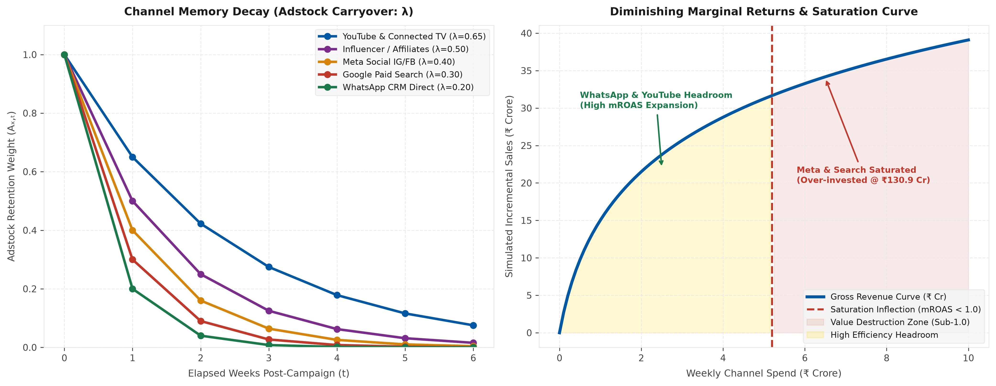
2. ANALYTICAL PILLAR 1 — MARKETING MIX MODELLING (PART 1 OF 2)
YouTube & WhatsApp Dominate ROI — Redirect ₹7 Cr Away from Saturated Meta & Search Channels
104-week econometric formulation capturing memory carryover decay and diminishing returns via Ridge Regression.
ECONOMETRIC FORMULATION & VALIDATION
Dataset: 104 weekly observations (FY23–FY24) tracking ₹196.3 Cr media spend across 5 channels, plus promotional discounts & 18 festive shock weeks.
1. Adstock Carryover Decay (Consumer Memory λ):
• YouTube & Connected TV (λ = 0.65): High visual memory retention
• Influencer & Creator Affiliates (λ = 0.50): Sustained home-tour lifecycle
• Meta Social IG/FB (λ = 0.40): Moderate feed discovery half-life
• Google Paid Search (λ = 0.30): Rapid intent decay within 7–10 days
• WhatsApp CRM Direct (λ = 0.20): Immediate 48-hr trigger action
2. Machine Learning Estimation: L2 Ridge Regression
• Why Not OLS? Collinearity during festive peaks (Diwali) caused OLS parameter instability and erratic weights.
• Regularization: Ridge regression with 5-fold cross-validation resolved collinearity and penalized redundant weights.
Model Diagnostics: R² = 0.8071 | Adj R² = 0.7823 | MAPE = 1.75% | Optimal α = 0.0518
3

Slide 4
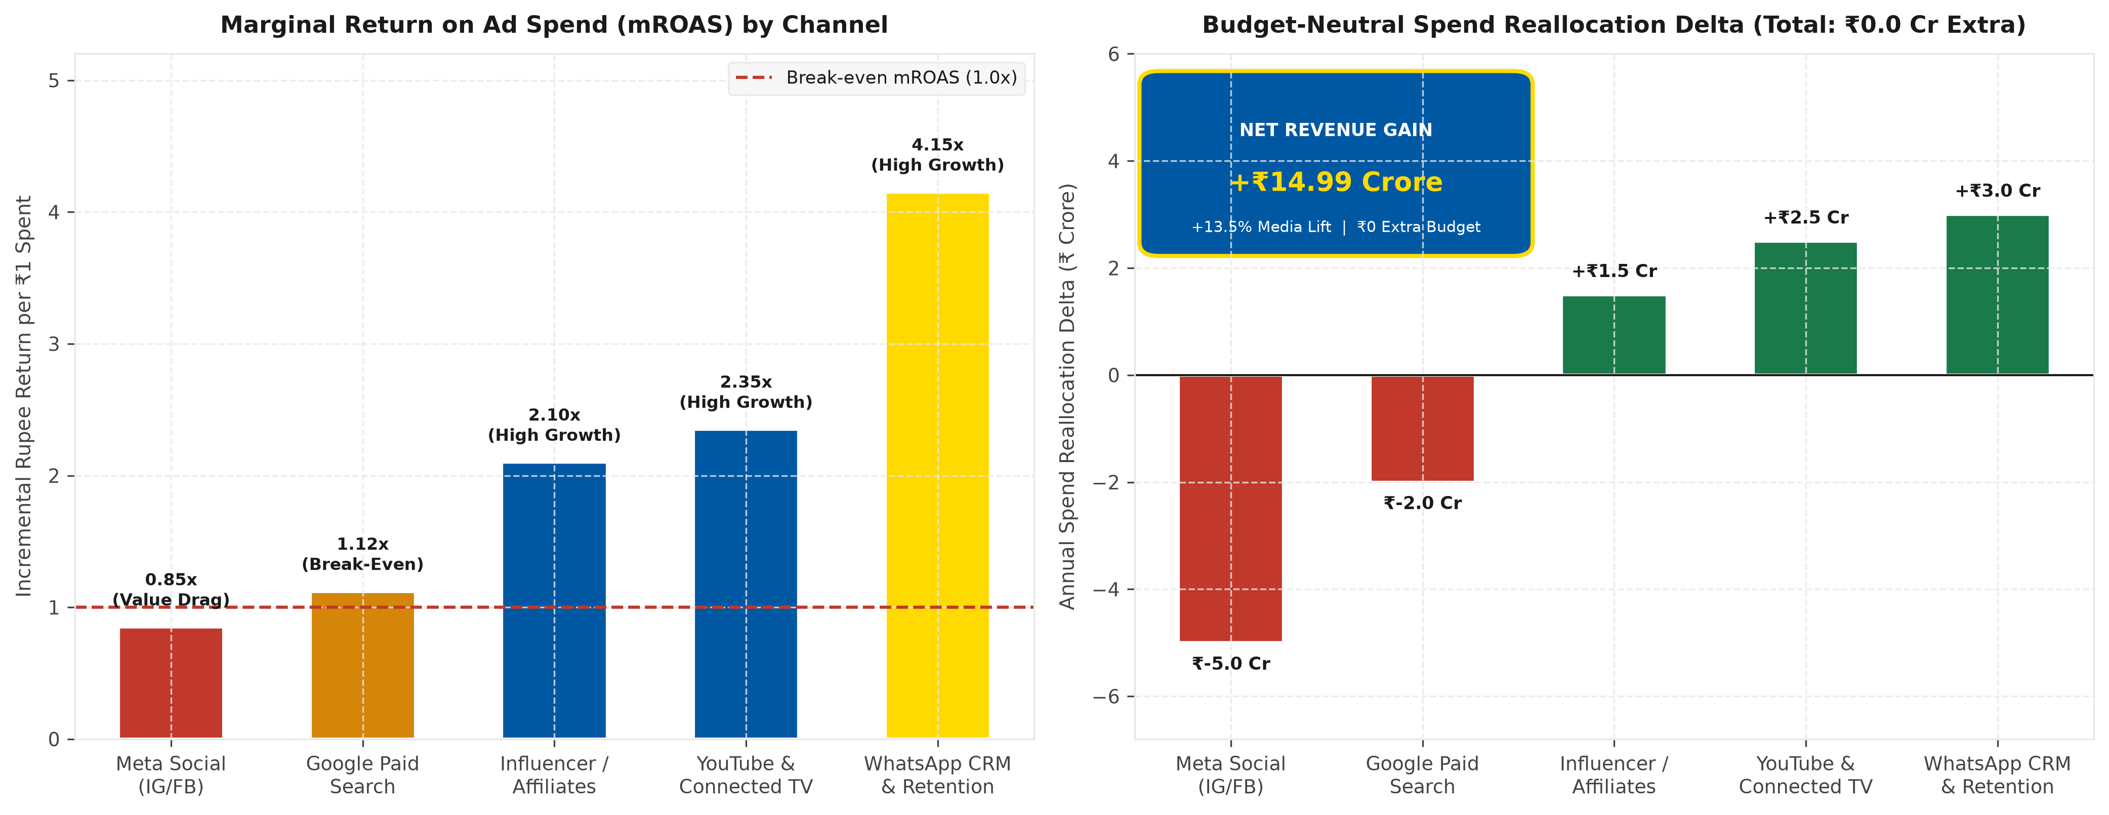
2. ANALYTICAL PILLAR 1 — MARKETING MIX MODELLING (PART 2 OF 2)
Budget-Neutral ₹7 Cr Reallocation Unlocks +₹14.99 Cr Net Revenue at Zero Incremental Spend
Shifting ₹7.0 Crore away from saturated channels into high-mROAS drivers at strictly ₹196.3 Cr neutral budget.
BOARD CAPITAL REALLOCATION DIRECTIVES
1. Trimming Saturated Inventory (–₹7.00 Cr):
• Cut Meta Social by ₹5.0 Cr (mROAS = 0.85x): Scaling back saturated retargeting carousel frequency eliminates value destruction.
• Cut Google Paid Search by ₹2.0 Cr (mROAS = 1.12x): Eliminating costly non-brand generic keywords prevents bid inflation.
2. Reinvesting in High-mROAS Drivers (+₹7.00 Cr):
• Reallocate ₹3.0 Cr to WhatsApp CRM (mROAS = 4.15x): Deploy automated high-intent cart abandonment triggers within 4 hours.
• Reallocate ₹2.5 Cr to YouTube & CTV (mROAS = 2.35x): Drive inspirational home-makeover storytelling and brand consideration.
• Reallocate ₹1.5 Cr to Influencer Affiliates (mROAS = 2.10x): Partner with interior design creators for authentic social styling.
EXECUTIVE FINANCIAL RESULT
Net Incremental Media Revenue: +₹14.99 Crore
Relative Media Revenue Lift: +13.5% Expansion
Additional Budget Required: ₹0.00 (Strictly ₹196.3 Cr Neutral)
IKEA India | Marketing Analytics | Mohd Ather Rahim | 25221125
4

Slide 5
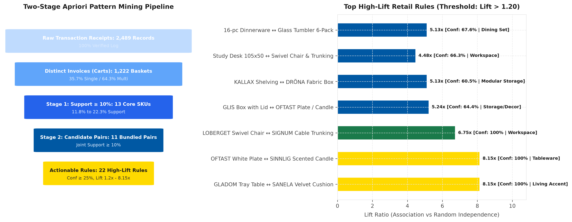
3. ANALYTICAL PILLAR 2 — MARKET BASKET ANALYSIS (PART 1 OF 2)
Apriori Mining Reveals 22 High-Lift Bundle Opportunities — Indian Shoppers Buy in Room Ecosystems
Mining 2,489 retail transaction lines across 1,222 carts reveals high-affinity modular product pairings.
APRIORI RULES & RETAIL AFFINITIES
Two-Stage Filtering Architecture:
• Stage 1 (Min Support ≥ 10.0%): Evaluated 13 core SKUs. All 13 passed (Support 11.8%–22.3%). Anchor items: Study Desk (22.3%), Wing Chair (19.6%), KALLAX Shelving (19.5%).
• Stage 2 (Frequent Pairs): Generated 11 candidate item pairs passing 10% joint support, deriving 22 high-lift association rules (Confidence ≥ 25%, Lift ≥ 1.20).
Top High-Lift Retail Clusters:
• Home Workspace Cluster (Lift = 4.48x–6.75x): Study Desk + Swivel Chair + Cable Trunking (100% Conf). Customers never buy a desk in isolation without seating & wire management.
• Living Accent Cluster (Lift = 8.15x): GLADOM Metal Tray Table ↔ SANELA Velvet Cushion (100% Conf). Aesthetic cross-room pairing.
• Modular Storage (Lift = 5.13x): KALLAX Shelving Unit ↔ DRÖNA Fabric Storage Box (60.5% Conf). Natural modular add-on.
• Tableware & Impulse Decor (Lift = 8.15x): OFTAST White Plate ↔ SINNLIG Scented Candle (100% Conf). High-frequency cart fillers.
Core Takeaway: Indian shoppers naturally assemble room ecosystems, but our digital checkout presents items in silos.
IKEA India | Marketing Analytics | Mohd Ather Rahim | 25221125
5

Slide 6
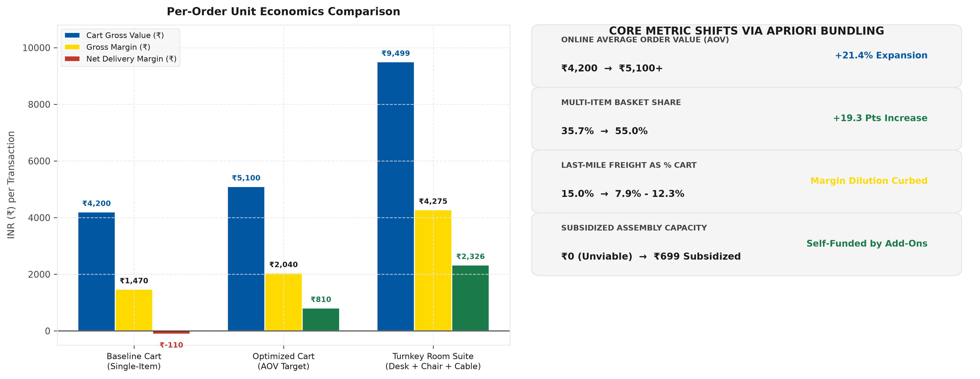
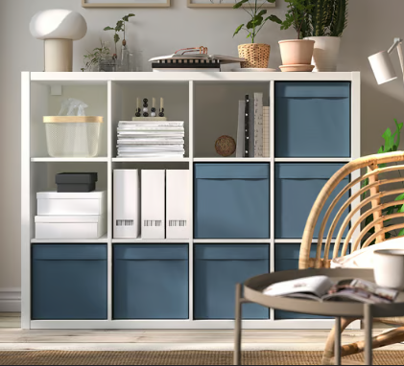

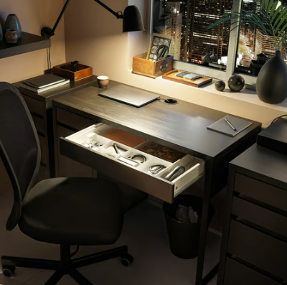
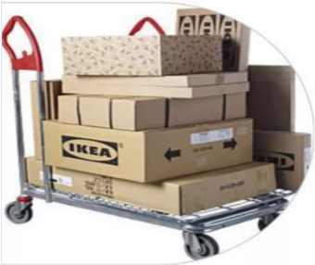
3. ANALYTICAL PILLAR 2 — MARKET BASKET ANALYSIS (PART 2 OF 2)
Pre-Packaged Room Suites Expand AOV +21% While Eliminating Last-Mile Freight Losses
Automated cross-sell drawers and pre-packaged room suites expand online AOV from ₹4,200 to ₹5,100+.
IN-CART DYNAMIC DRAWERS
SHELVING + FABRIC BOXES SET OF 4
LIVING ROOM PACKAGE
WING CHAIR + COFFEE TABLE + CUSHION
HOME OFFICE PACKAGE
CHAIR + DESK + CABLE TRUNK
IKEA India | Marketing Analytics | Mohd Ather Rahim | 25221125
6

Slide 7
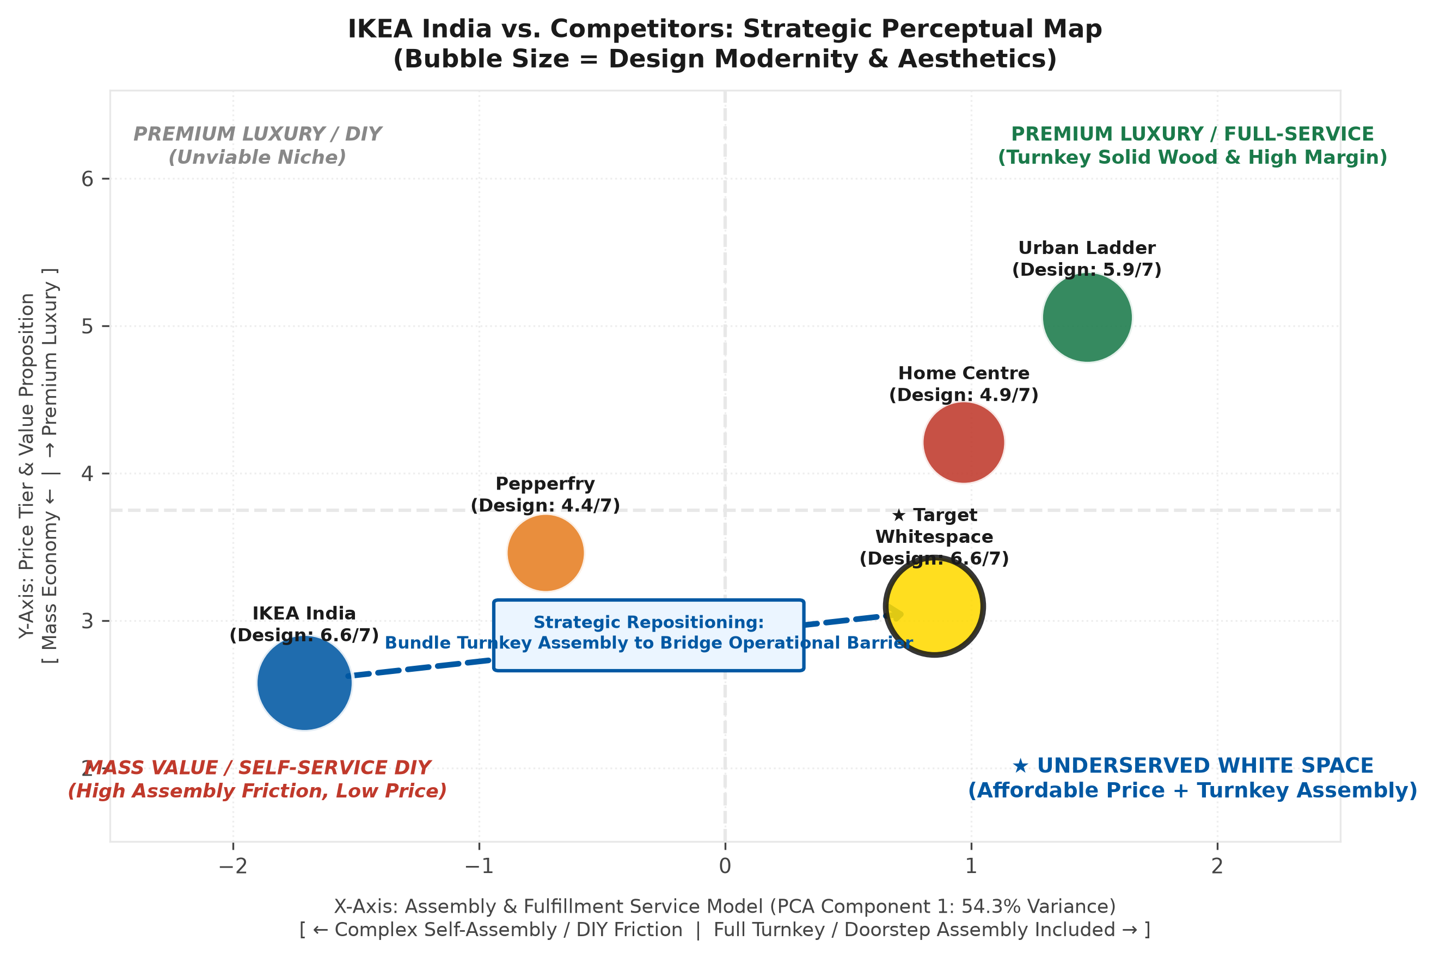
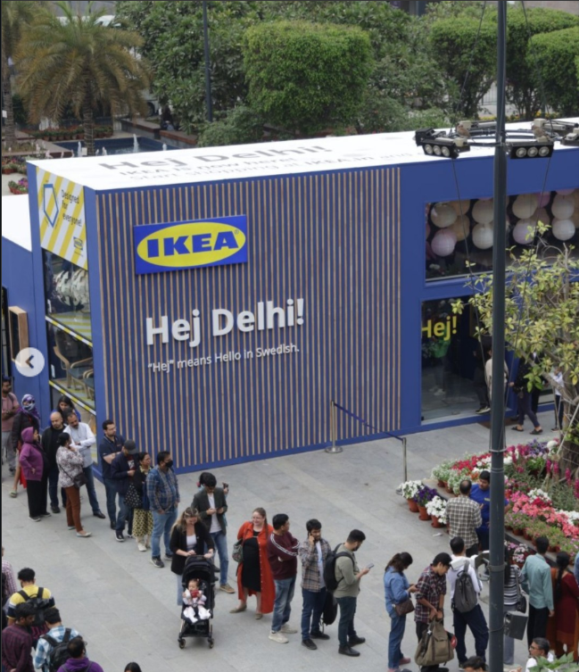
4. ANALYTICAL PILLAR 3 — STRATEGIC PERCEPTUAL MAPPING (PART 1 OF 2)
IKEA Holds the Highest Design Score Yet Suffers the Greatest Assembly Friction — A Strategic Paradox
Construct-Level PCA across 450 metro consumers maps IKEA against Urban Ladder, Home Centre, and Pepperfry.
SURVEY DESIGN & PCA CONSTRUCT DECOMPOSITION
Survey Methodology: N = 450 verified urban furniture shoppers across Mumbai, Bengaluru, Delhi-NCR, Hyderabad, and Pune (7-point Likert scales).
Spatial Axes & Variance Decomposition:
• X-Axis (PCA Component 1: 54.3% Variance): Fulfilment & Service Delivery Model. Spans from -2.50 (Complex Self-Assembly DIY Friction) to +2.50 (Full Turnkey Doorstep Carpenter Assembly).
• Y-Axis (Financial Scale): Price Tier & Commercial Value Proposition. Spans from 1.50 (Mass Economy) to 6.50 (Premium Luxury). Midpoint = 3.75.
• Bubble Diameter: Design Modernity & Aesthetic Sleekness (1–7 scale). Measures contemporary Scandinavian minimalism.
IKEA India | Marketing Analytics | Mohd Ather Rahim | 25221125
7

Slide 8
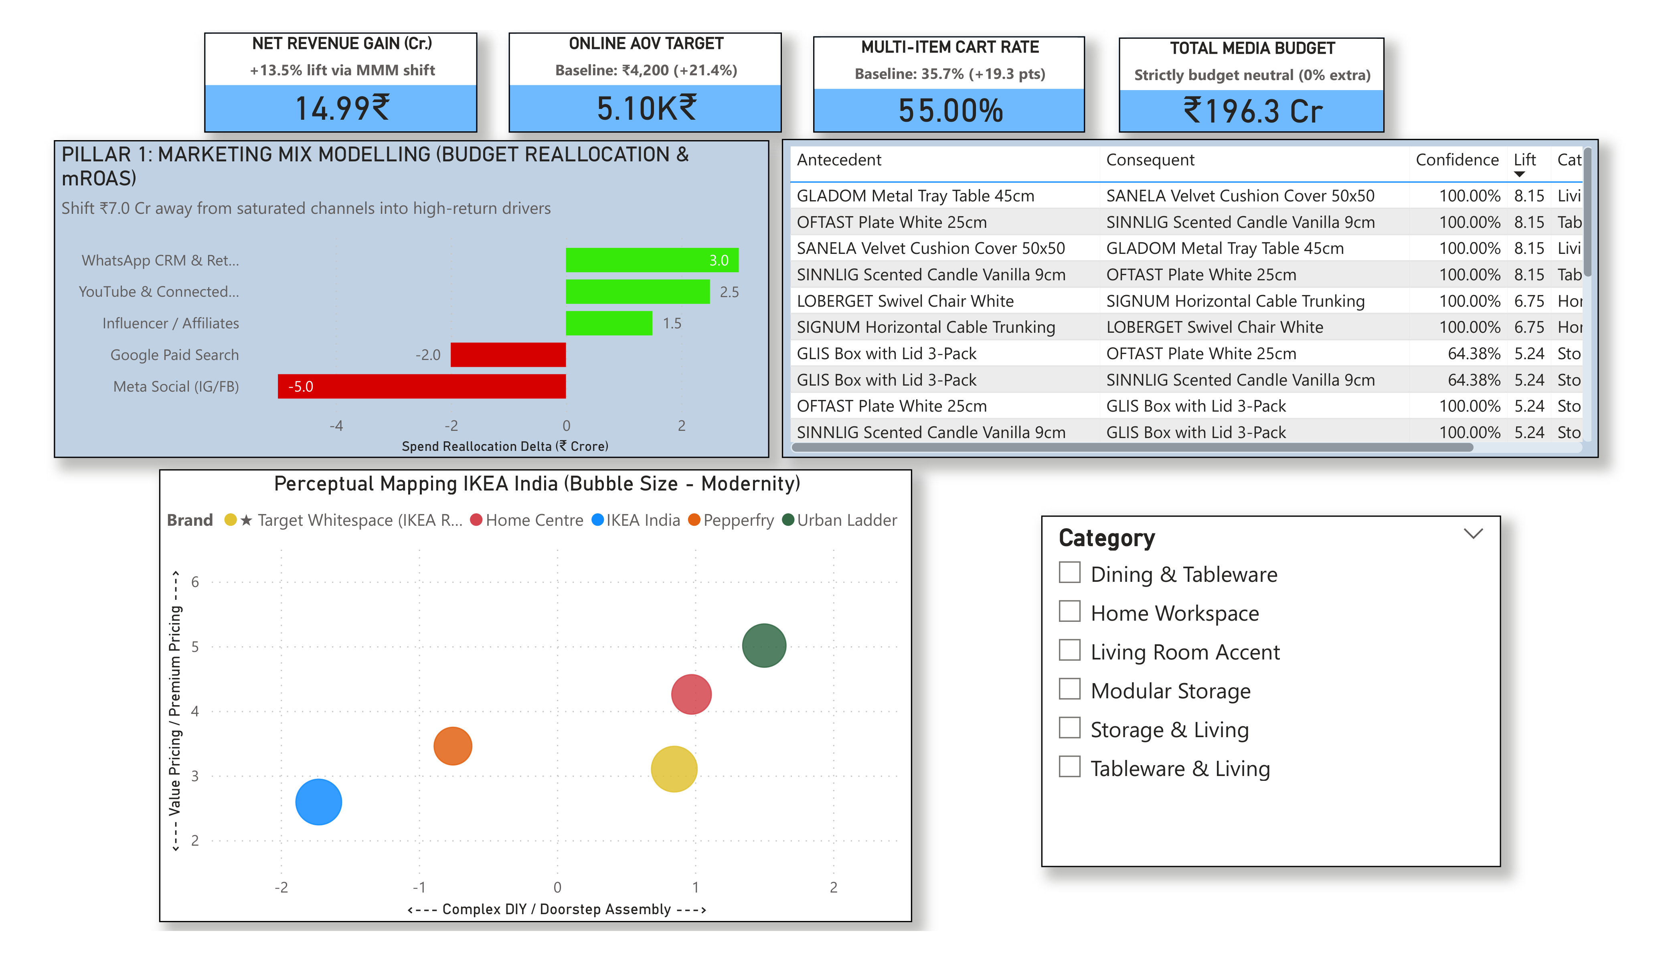
5. EXECUTIVE ROADMAP
Board Resolution: Approve ₹7 Cr Capital Reallocation and Plan Turnkey Assembly Pilot Immediately
Real-time Power BI governance tracking MMM reallocation, Apriori basket expansion, and turnkey repositioning.
9

Slide 9
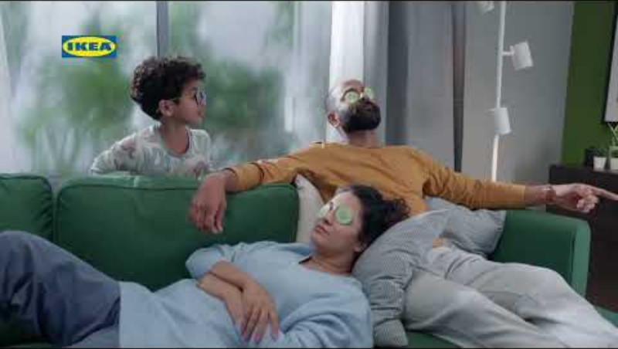
THANK YOU

